Slide 1


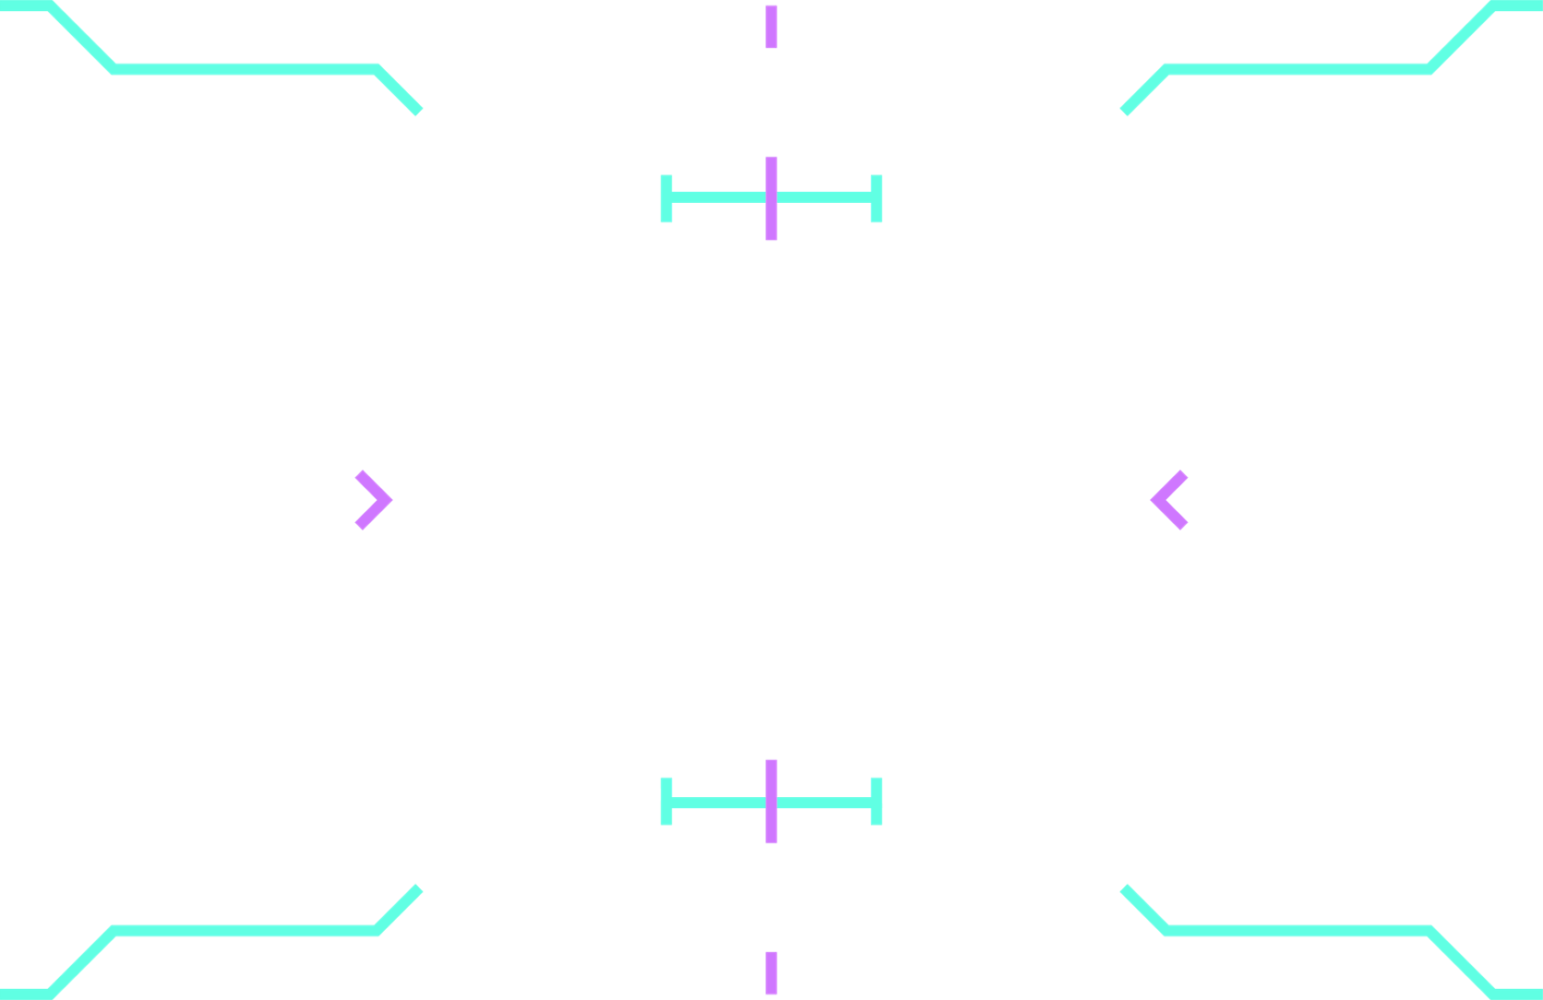




Rocket Factory Tycoon
By Meerab Khan & Jacob Magera

Slide 2

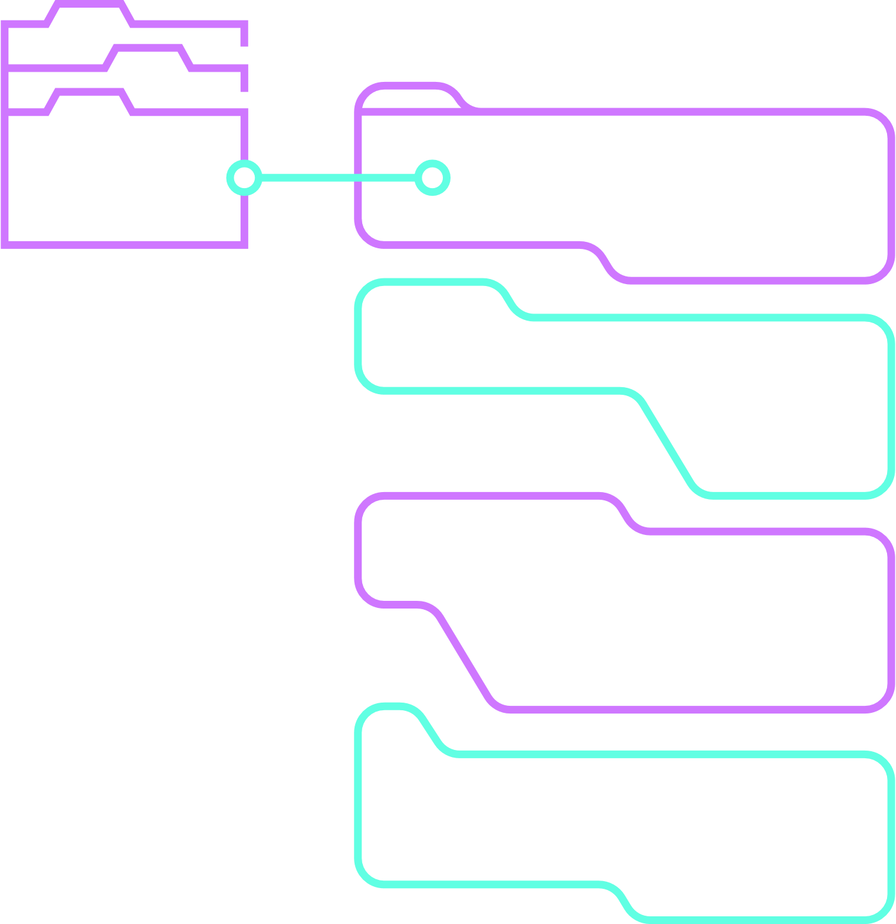

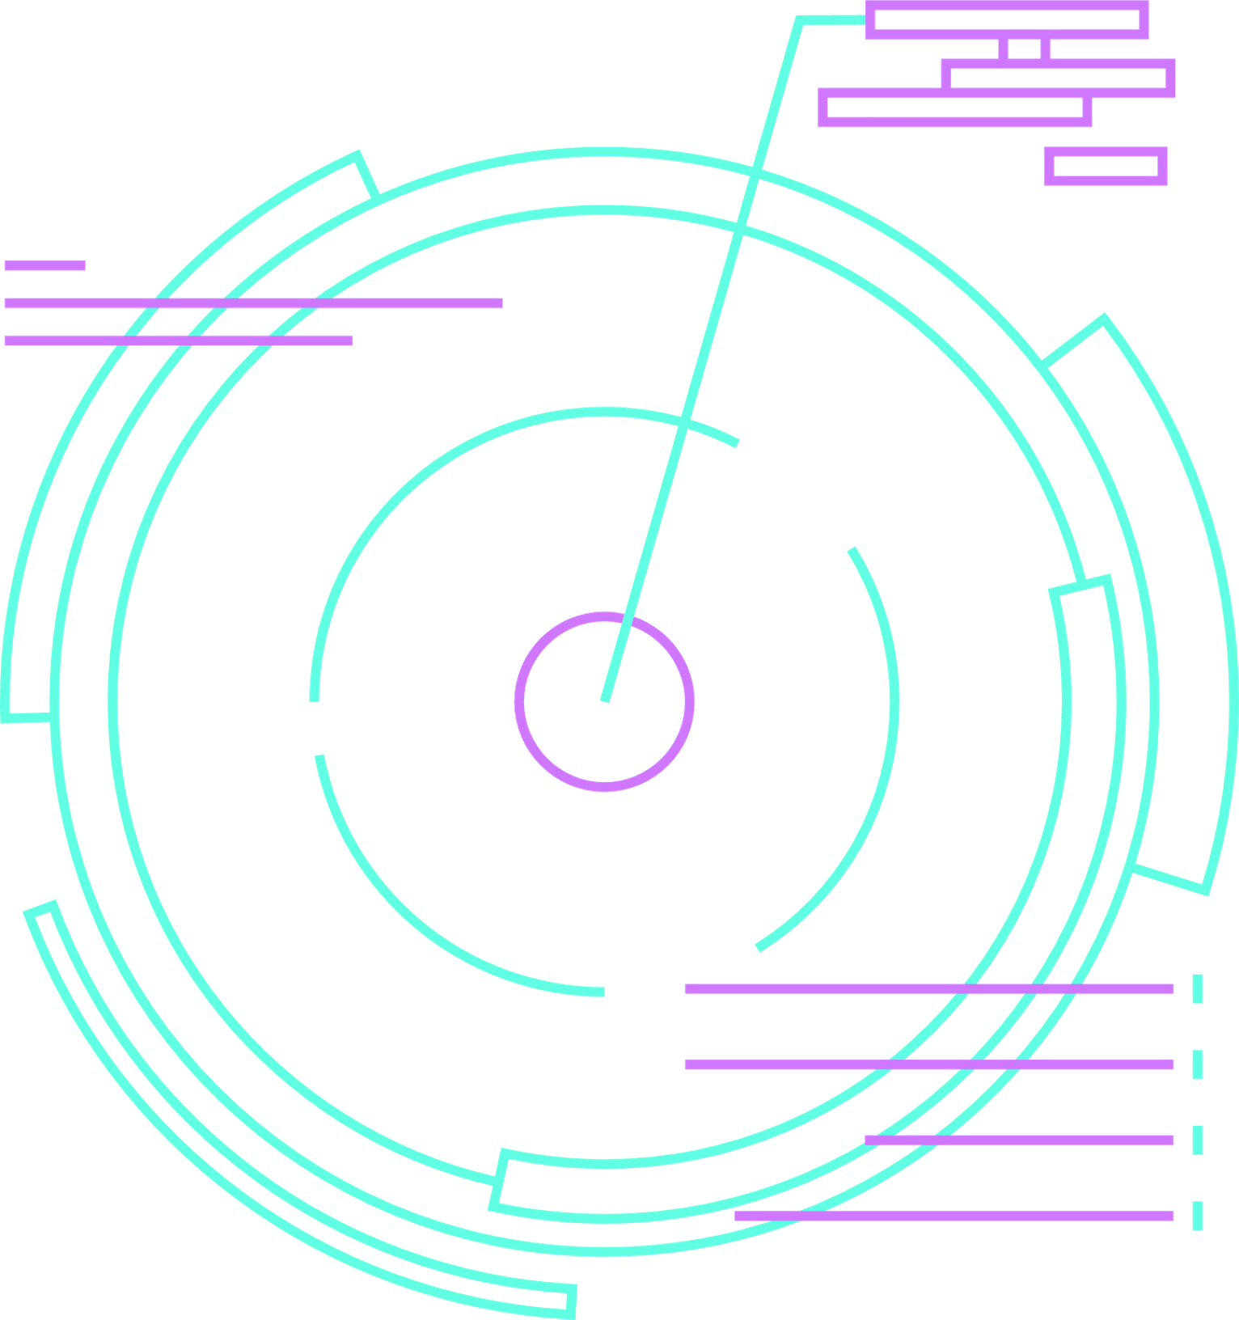

Introduction
Our clicker game application, named “Rocket Factory”, is a GUI-based game application that aims to entertain players and provide a sense of fun and accomplishment as they progress through the game. It will also allow the user to choose between an active (via clicking and upgrades) or passive playstyle (via automatic earning points with helpers);

Slide 3

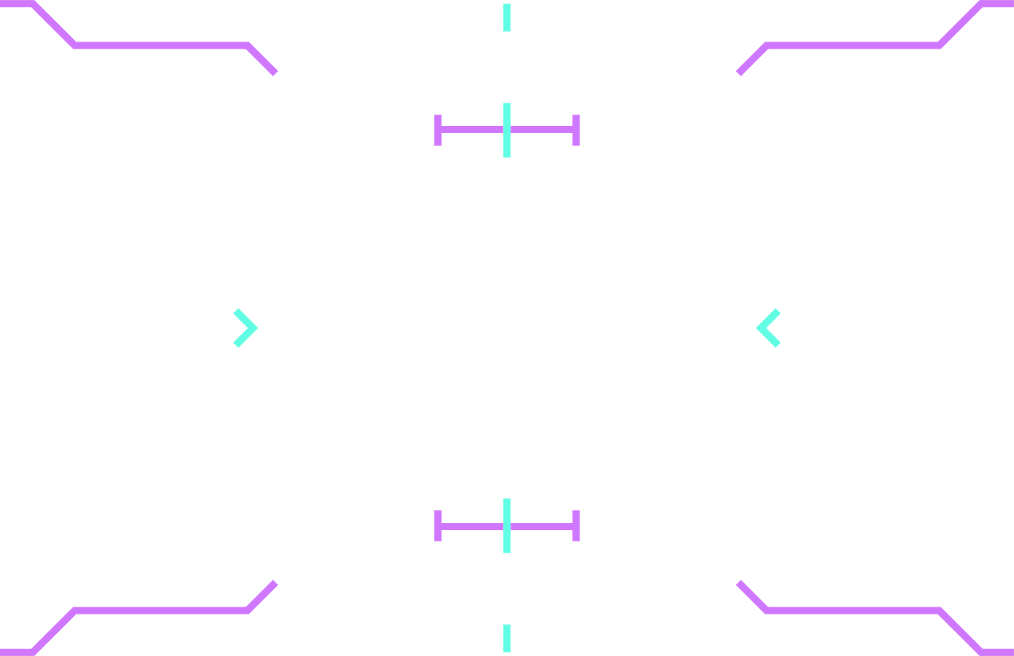
MECHANICS
01
Click on the rocket ship to earn points!
02
Buy helpers to produce points passively!
03
Buy new rockets and summon meteor showers to improve the amount of points earned from clicking!
04
Unlock new areas to change up the scenery!
05
Have fun!

Slide 4



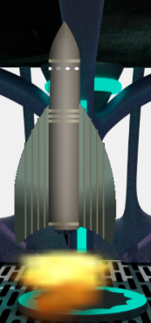

1
The button is centered in middle of the screen. It has a background image set to a rocket, which can be changed to different images rockets based on the rocket enhancement feature. There is flame animation beneath the rocket with 13 frames of flames. The button offers better accuracy of clicks than picture box or any other UI control.

Slide 5
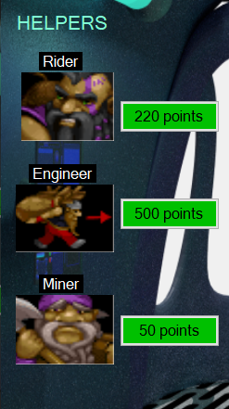
2
Helpers are on the right-hand side of the screen. They can be purchased via points earned in game which produce passive points. There are three types of helpers with there are names in label and different costs. After each successful purchase of a helper that helper's cost increases by 1.25. The points update in real-time with the timer UI.

Slide 6
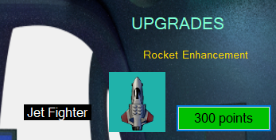
3
Rocket Enhancements is an upgrade feature that lets the user switch between rockets and earn points after purchasing a rocket. We added three different rockets with different names and cost. The image of rocket is shown in picture box and they switch to the next after buying a rocket.

Slide 7
3
Rocket Enhancements is an upgrade feature that lets the user switch between rockets and earn points after purchasing a rocket. We added three different rockets with different names and cost. The image of rocket is shown in picture box and they switch to the next after buying a rocket.

Slide 8



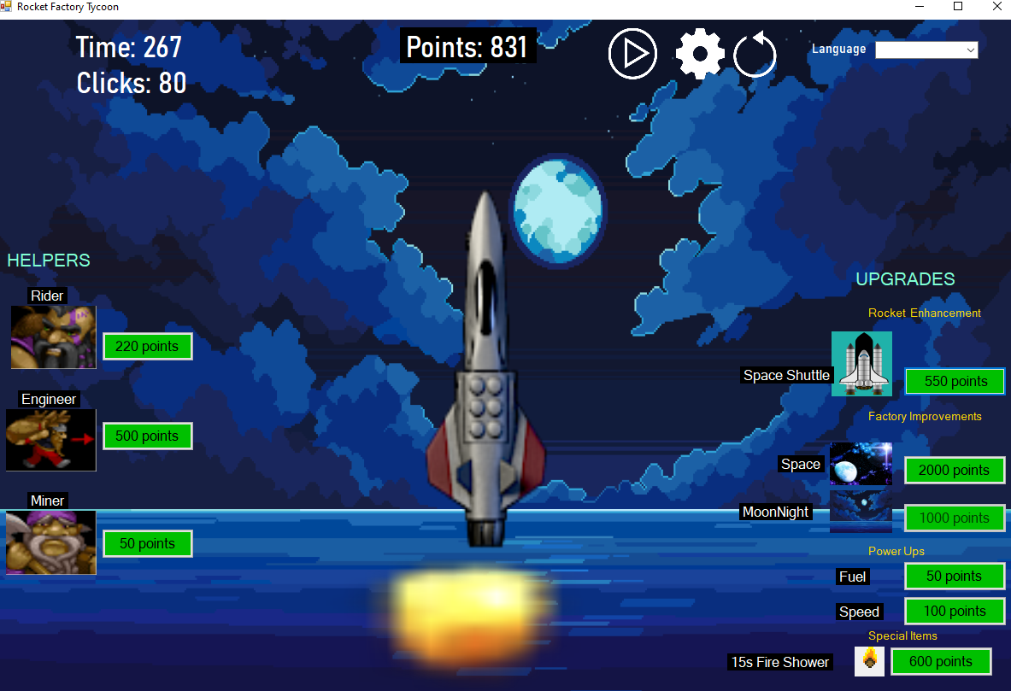


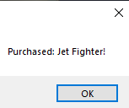
4

Slide 9
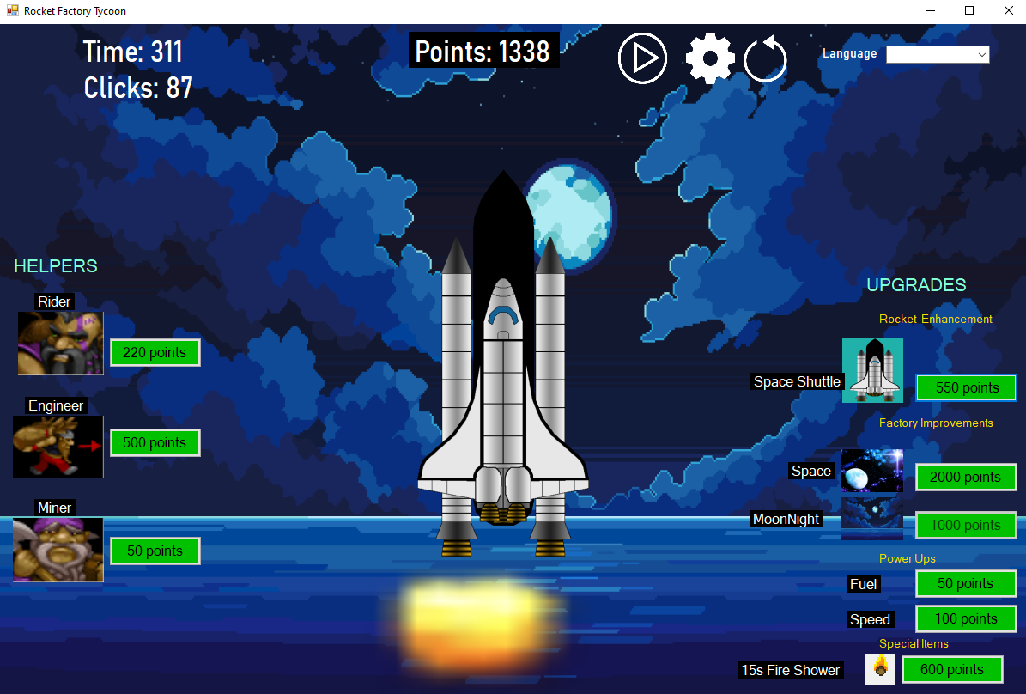
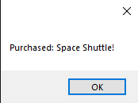
4

Slide 10
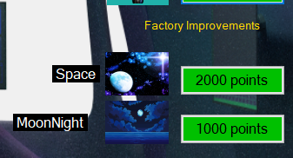
5
Factory Improvements changes the background image of the form to the one the user choses. It also ensures the user can't buy the same background over again.

Slide 11
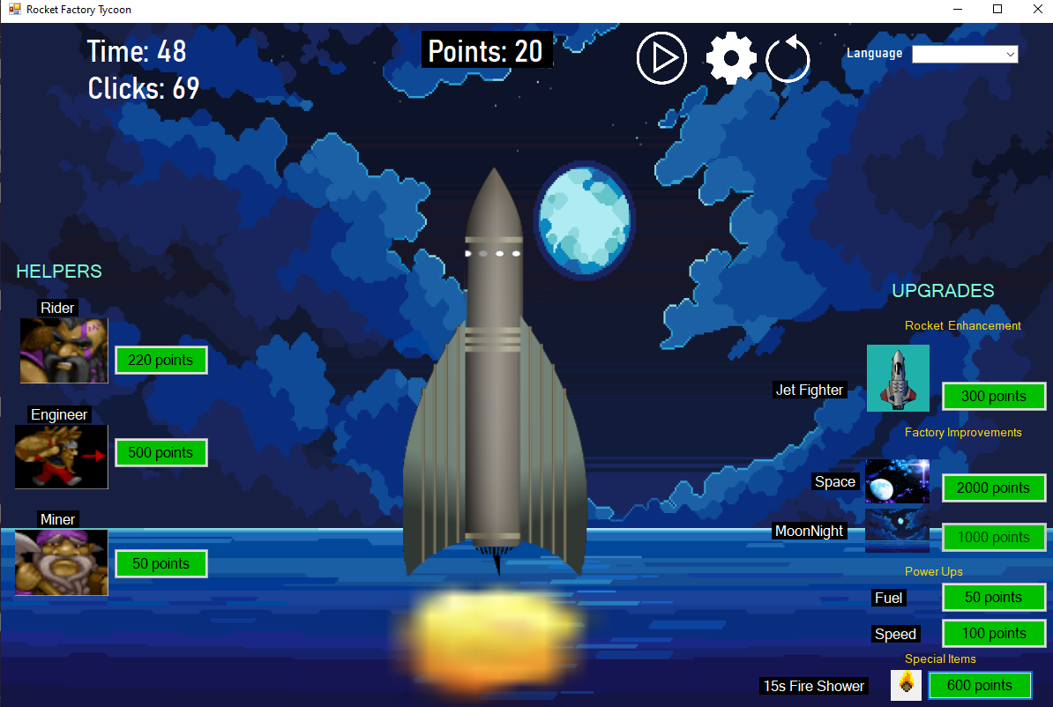
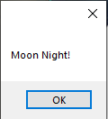
5

Slide 12
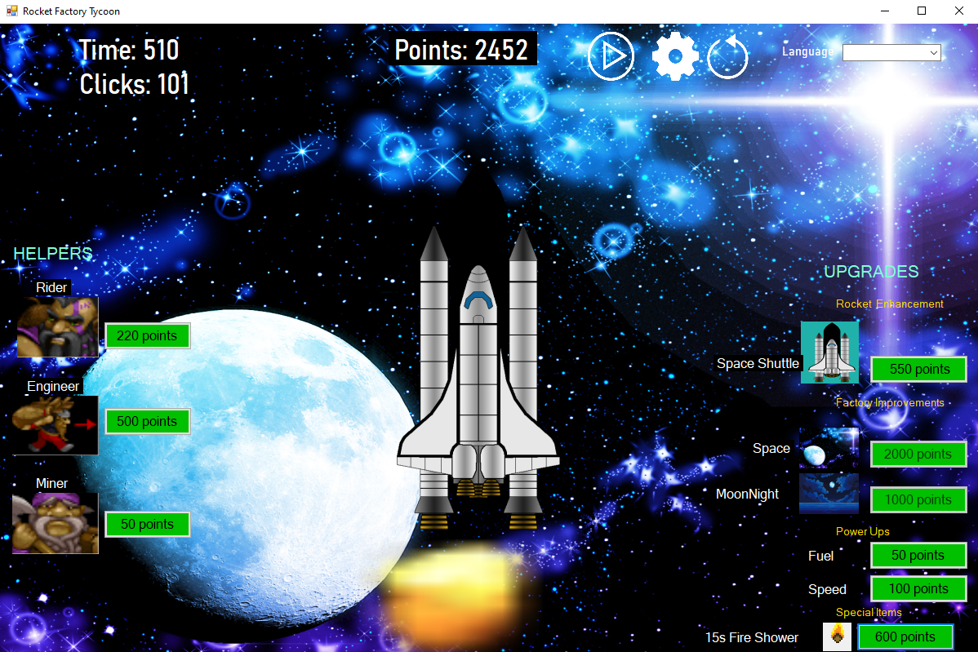
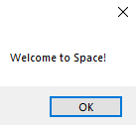
5

Slide 13
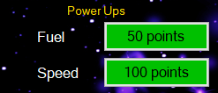
6
Power Ups simply increase points more than any other upgrade. For example fuel increases points by 100 per click, while speed by 200.

Slide 14
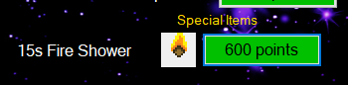
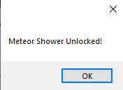
7
Special Items increases points and has a time limit of 15 seconds for a fire meteor shower. Each fire image is in a picture box and has a falling speed.

Slide 15
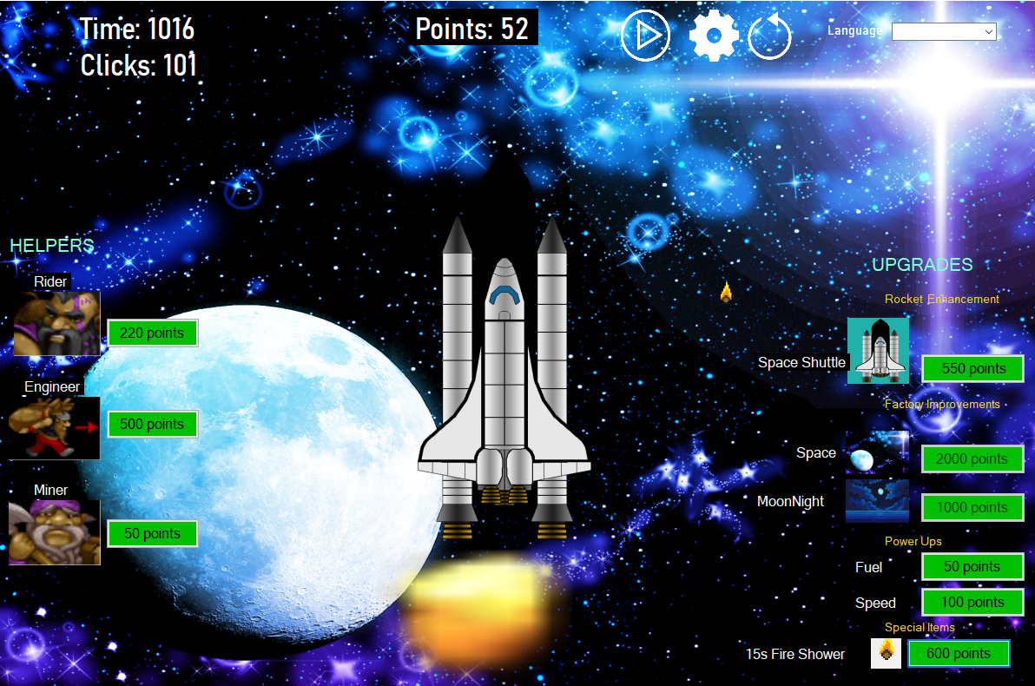
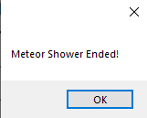
7

Slide 16

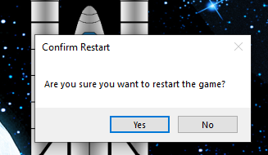
8
Restart Button lets you restart the game without running application from the IDE. If no is selected then game continues.

Slide 17
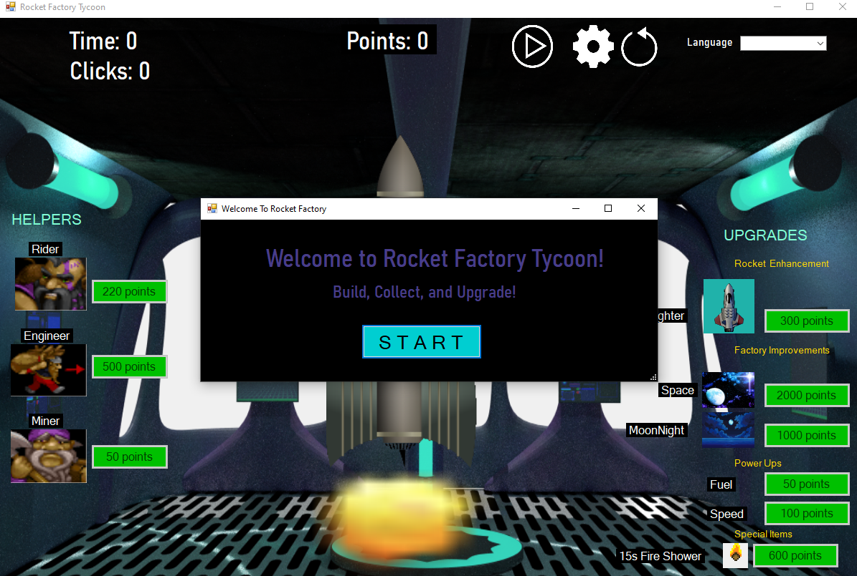
8

Slide 18


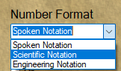
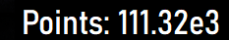
9
In the settings screen there are three options that change the way numbers are displayed.

Slide 19
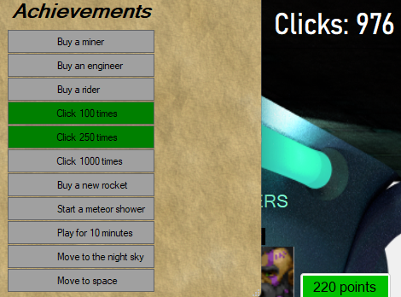
9
In the settings screen there is also an achievement list, where you can unlock achievements as you progress!

Slide 20
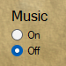
9
The last feature in the settings screen is a sound option, allowing you to disable and enable the background music at will

Slide 21
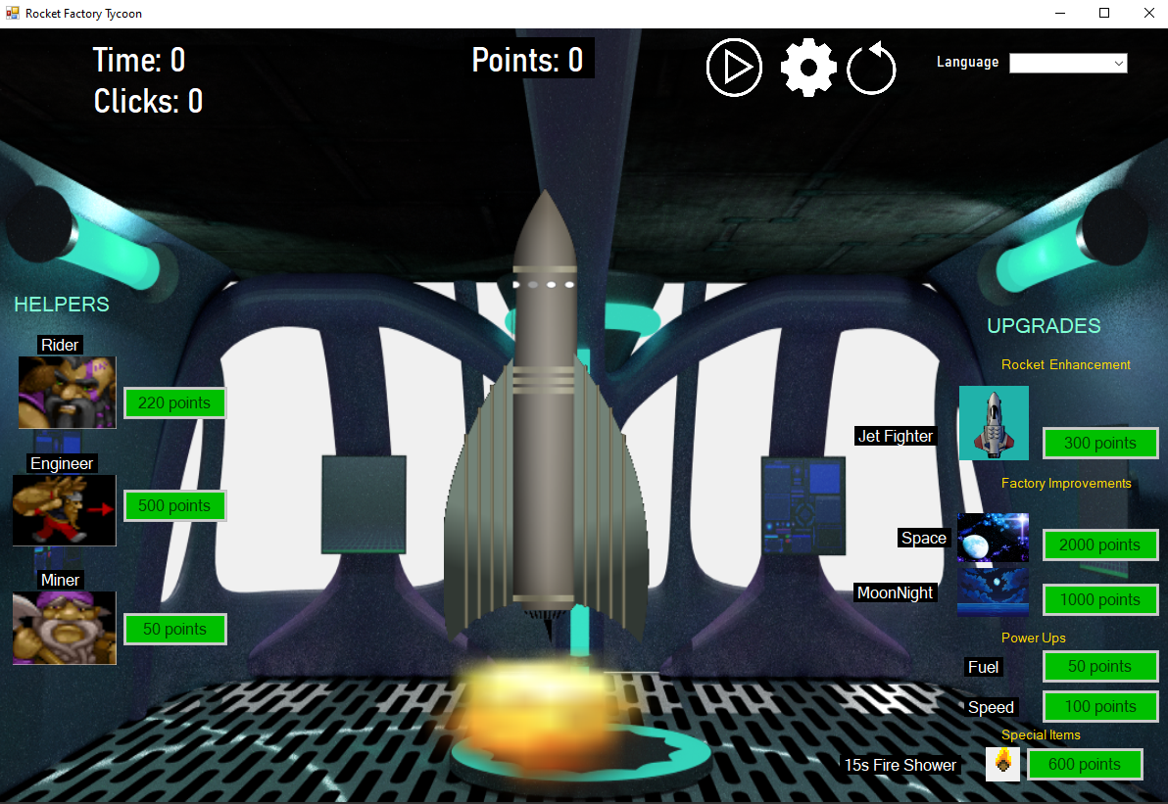
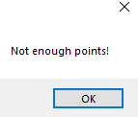

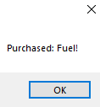
10
Some more Exception Handling
Buttons are disabled until user clicks the play button.

Slide 22
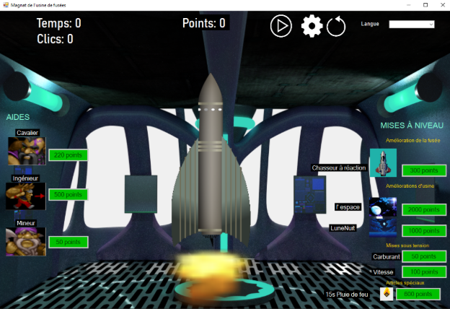
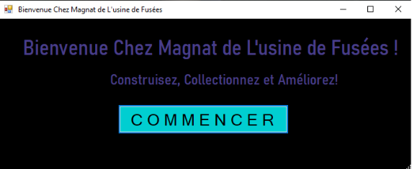
11
French translation

Slide 23
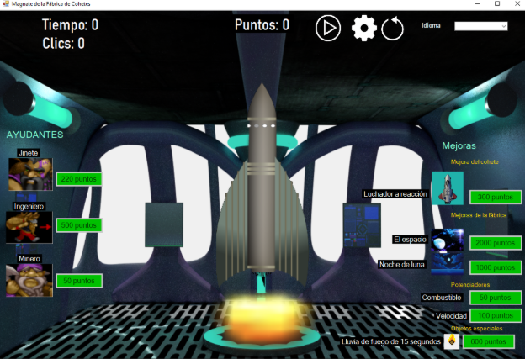
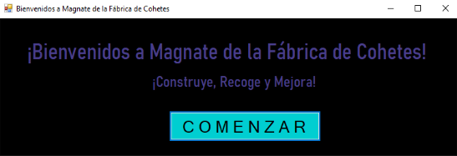
12
Spanish translation

Slide 24


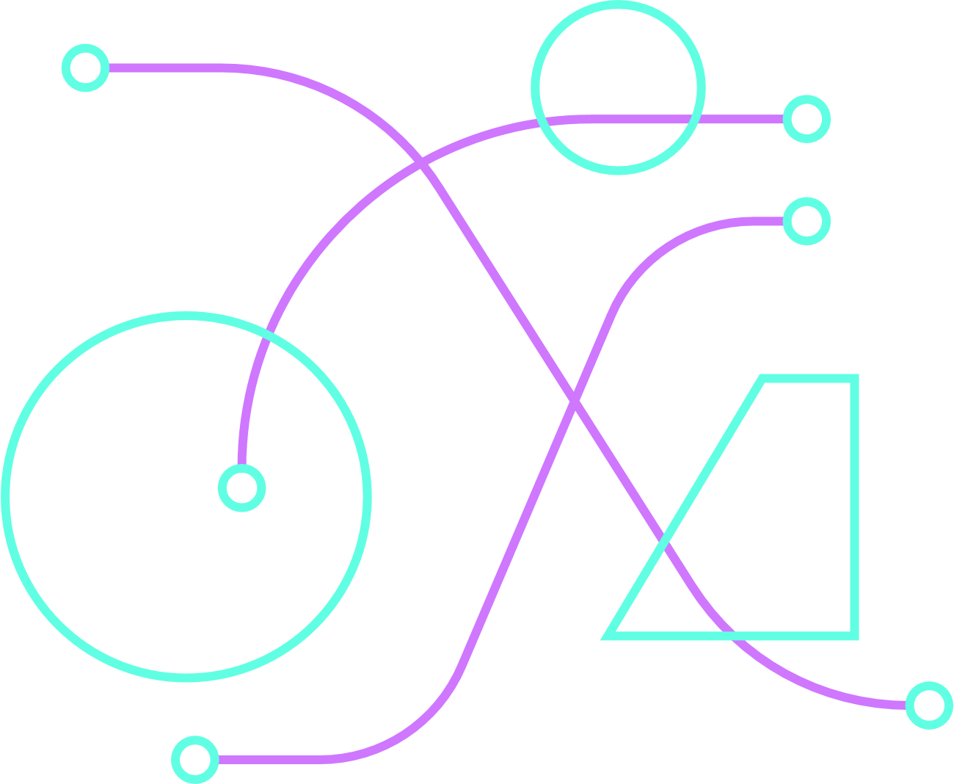

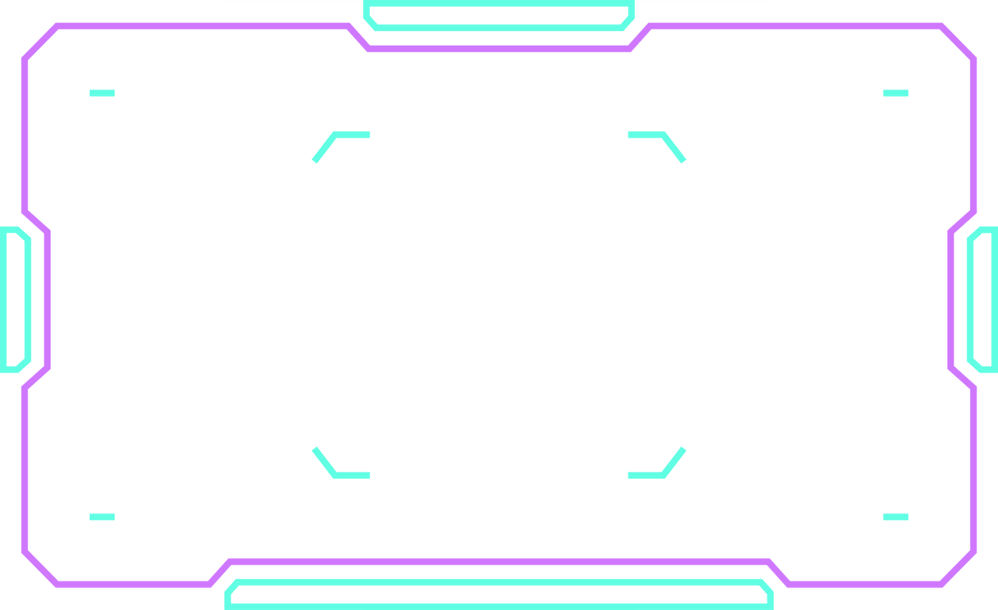


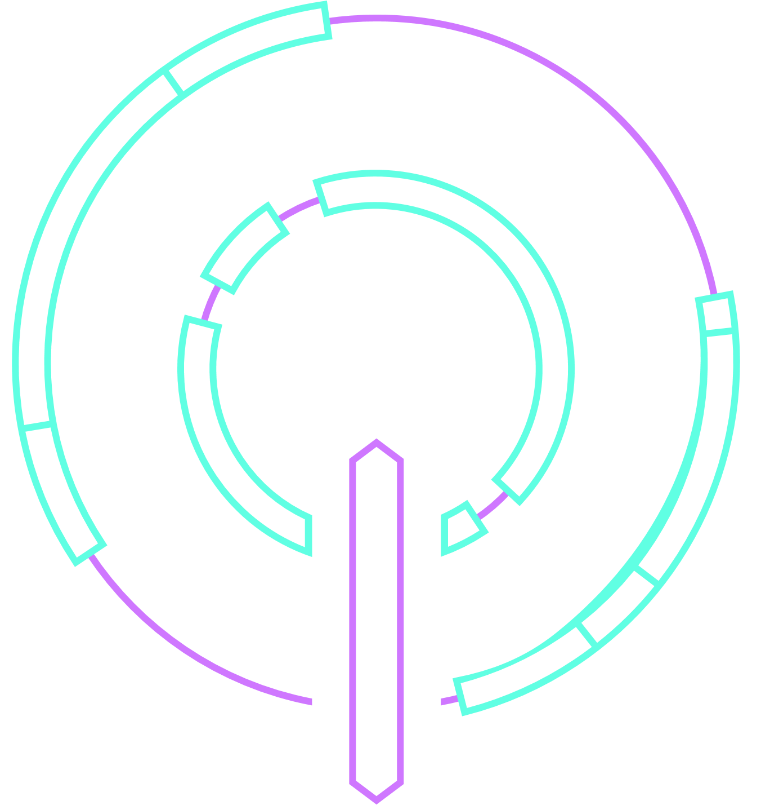

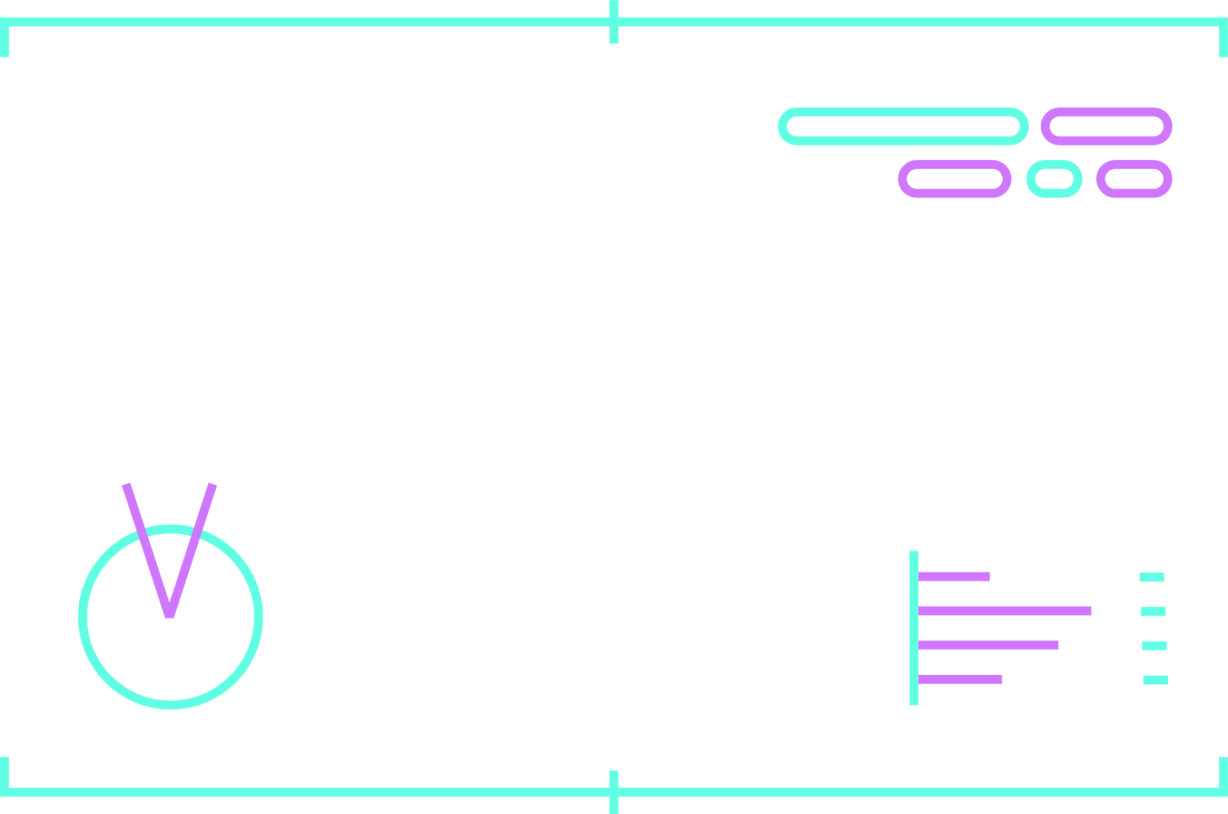
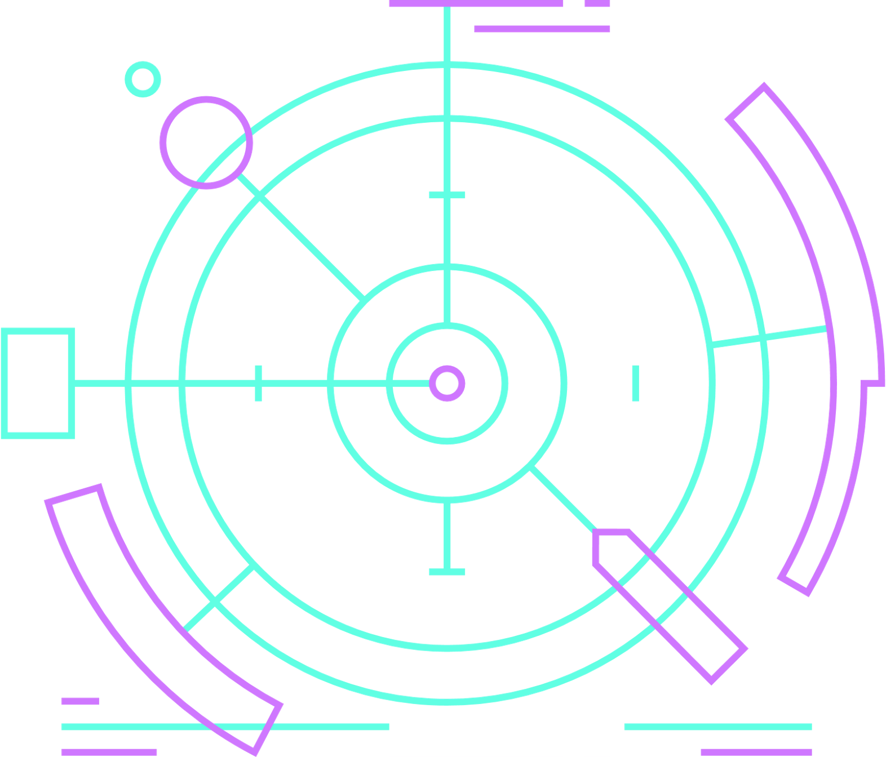
Thank You

